Slide 1
Employee Data Analysis Using Excel
STUDENT NAME : PRAKASH. K. V
REGISTER NO: 312211654
DEPARTMENT: B. COM GENERAL (COMMERCE)
COLLEGE: THIRUTHANGAL NADAR COLLEGE

Slide 2
PROJECT TITLE:
USING PIVOT TABLES FOR EMPLOYEE TURNOVER ANALYSIS

Slide 3
AGENDA:
Problem statement
Project overview
End users
Our solution and proposition
Data description
Modelling approach
Result
Discussion
Conclusion

Slide 4
Problem statement:
Analyze employee turnover trends and identify key factors contributing to turnover to inform retention strategies.

Slide 5
PROJECT OVERVIEW:
Utilize pivot tables to examine employee turnover data, uncover patterns, and provide actionable insights for HR and management.

Slide 6
END USERS:
HR professionals
Management
Business leaders and
Analyts seeking to understand and address employee turnover.

Slide 7
OUR SOLUTION AND PROPOSITION:
Leverage pivot tables to transform complex turnover data into easily digestible insights, enabling data-driven decisions and improved retention strategies.

Slide 8
DATA DESCRIPTION:
Employee turnover data, including :
• Employee ID
•Department
•Job Title
•Tenure
• Reason for Leaving
• Date of Departure
• Demographic data

Slide 9
MODELLING APPROACH:
Calculate turnover rates by department, job title, and tensure.
Identify top reasons for leaving.
Analyze trends in turnover over time.
Examine correlations between variables.
Filter and drill down into specific data segments.

Slide 10
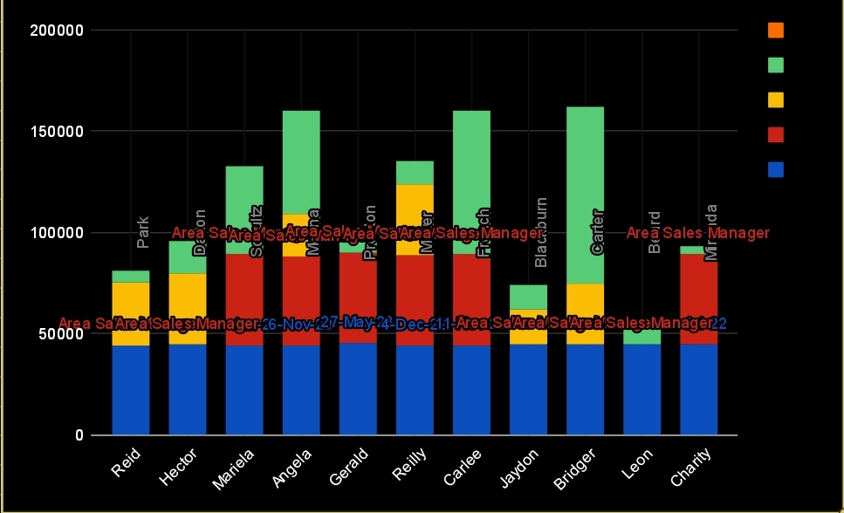
RESULTS:

Slide 11
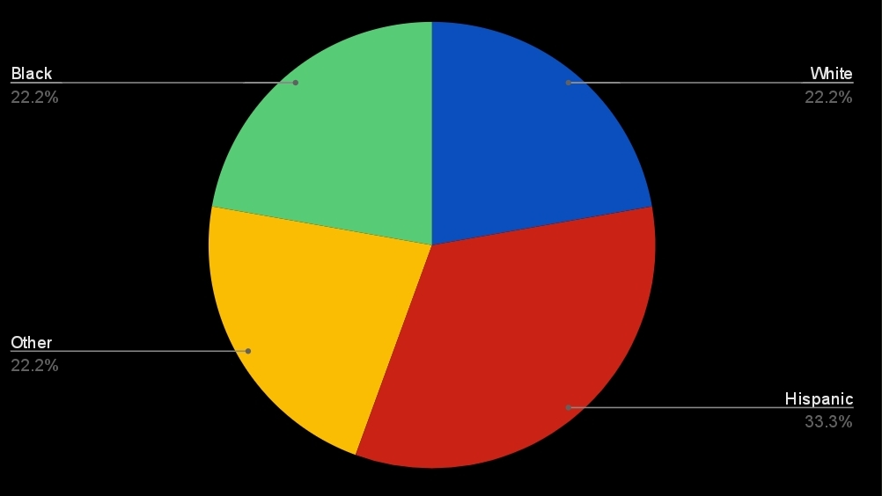

Slide 12
DISCUSSION:
Interpret results, highlighting key trends, insights, and implications for retention strategies. Discuss areas for further analysis and potential interventions.

Slide 13
Conclusion:
Summarize the value of using pivot tables for employee turnover analysis, emphasizing actionable insights, data-driven decision-making, and improved retention strategies.

